Slide 1
The lessons we fail to learn
Overcoming cycles of defeat
Grace Liew
26/08/2018

Slide 2

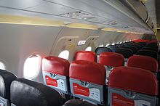
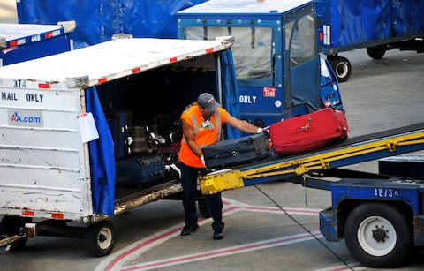
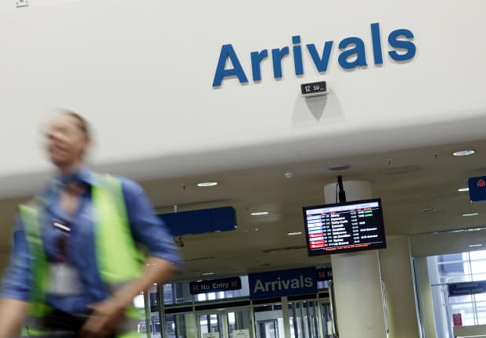
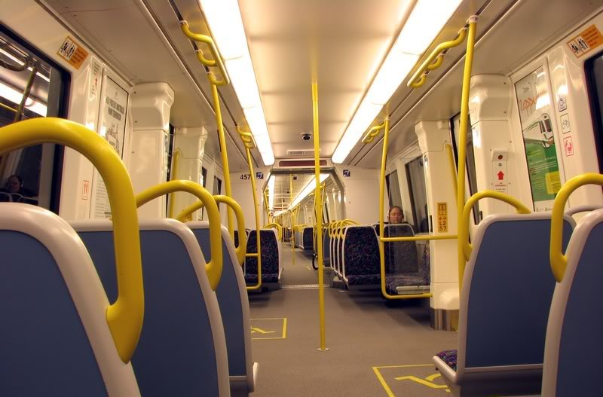
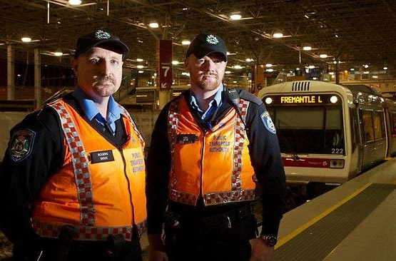
Can you relate to this?
The story of my life?
Notes:
Video debrief
What did you observe in the video? The wildebeest were talking to one another looking at a strange looking thing in the river. One thought it was a crocodile. The other thought it was a log. So Wildebeest #1 tried to prove to Wildebeest #2 who was very adamant that it wasn’t, that it was indeed a crocodile. Unfortunately, Wildebeest #1 paid the price with his own life. What happened at the end? Another Wildebeest came into the scene and what did he think it was? A log. The cycle then repeats itself. Why is it we fail to learn lessons unless we go through it ourselves?
My mobile phone
I recently lost my mobile phone twice within the space of a month. Some of us when we lose things, we literally have no idea where we misplaced our items. For me, in this instance, I actually knew where I left my mobile phone, I was just unable to retrieve it!
When I came back from M’sia, I put my mobile in the seat pocket which I am accustomed to do along with a few other things. But in my hurry to disembark the flight, I managed to pack into my bag the things I placed in the seat pocket …everything that is, except for my phone! I have travelled to many places and never have I made this mistake before. I only realised this when we arrived at the baggage carousel. I tried to speak to the airport staff handling baggage enquiries, the baggage handling crew, air asia stewardesses and eventually had to be taken care of by the airport staff who were the only ones authorised to enter the aircraft and retrieve my mobile phone. Phew!
After that, you would think that I would have learned my lesson. One day on the way home from work, I fell asleep on the train – which is not unusual. After I arrived home I realised that my phone was not in my handbag as I had thought. Immediately I knew that it must have been left on the train because that was the last time I remember holding it. Either one of two scenarios could have happened, it could have been stolen from me whilst I fell asleep or I could have dropped it / left it on the seat? Which would be odd but nevertheless an option. Anyway, lodged a lost property report, called Transperth, changed all my passwords, tried the google “find my phone” feature. I was told I would have to wait basically til the next day for any results. I prayed the “I want my knife back / mobile phone”. Anyway, rested at night and the next day, I was told that my phone had been found in Mandurah on the train. Basically, at the end of the line, they do a sweep and picked it up there. The following day, I was reunited with my phone as they expedited the process for me.
During that whole time, I realised how dependent I am on my mobile phone. Literally everything I do revolves around my phone. The first thing I reach for is my mob phone.
So, the lessons we fail to learn – where God has to teach me OVER and OVER again until it gets through my sometimes thick head.

Slide 3
Key Scriptures
Rev 12:11
And they overcame him by the blood of the Lamb and by the word of their testimony, and they did not love their lives to the death.

Slide 4
Key Scriptures
Phil 3:10-15
That I may
Know Him and
The power of His resurrection, and
The fellowship of His sufferings, being conformed to His death,
If, by any means, I may attain to
The resurrection from the dead.
Not that I have already attained, or am
already perfected;
but I press on, that I may lay hold of that
for which Christ Jesus has also laid hold of me.

Slide 5
Key Scriptures
Phil 3:10-15 cont’d
Brethren, I do not count myself to
have apprehended;
but one thing I do,
forgetting those things which are behind and
reaching forward to those things which are ahead,
I press toward the goal for the prize of the upward call of God in Christ Jesus.
Therefore let us, as many as are mature, have this mind;
and if in anything you think otherwise,
God will reveal even this to you.

Slide 6
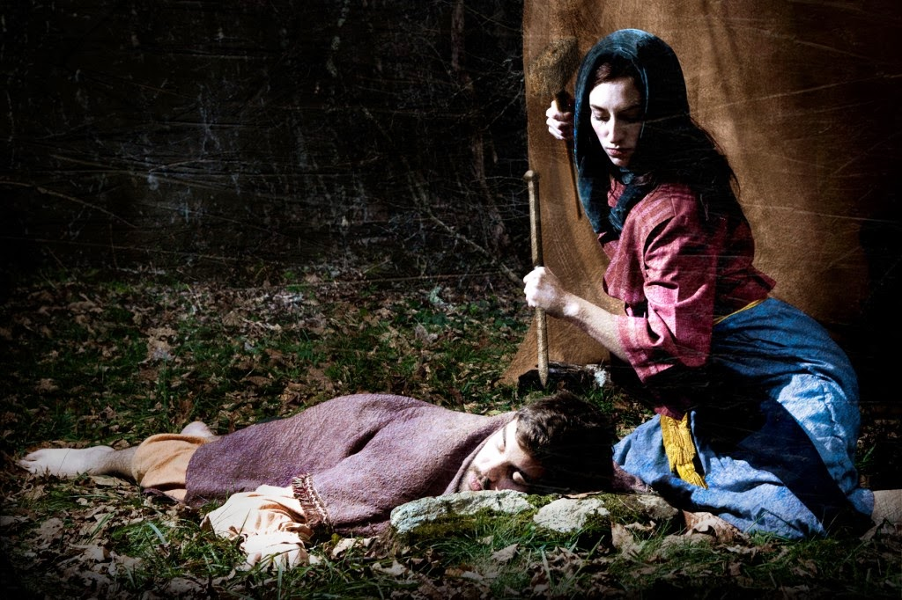
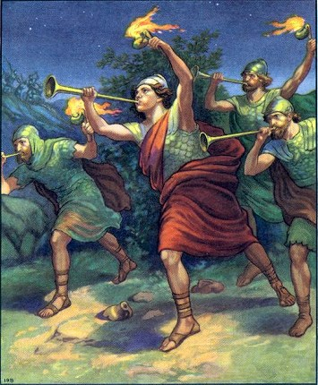
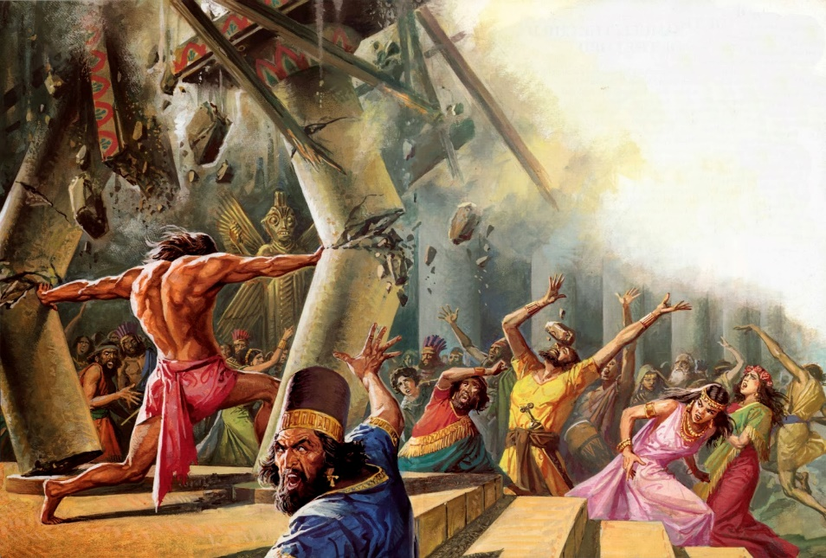
Judges – cycles of victory and defeat
Notes:
This month, we’re reading the book of Judges and it seems that there is a recurring theme / message in this book. The children of Israel were constantly in this cycle. Where they would get comfortable and forget God (go serve other Gods) and then when God raised up a neighbouring nation to oppress them, they would cry out to God to deliver them and then God would hear their cry and help them. Only for them to slip into complacency again. This continual cycle can be quite frustrating to read and makes us think “why couldn’t the children of Israel be better than that? Why can’t they learn from their lesson?” Except that we are no different.
So how do we overcome this cycle of defeat. Recognise the spirits that are operating in our lives. We are going to have to put our fighting gear on.

Slide 7
Overview
Give me this mountain!
    Overcoming the spirit of retirement
Give me a new heart and spirit
  Overcoming the spirit of apathy
That I may know Him
Overcoming the spirit of familiarity

Slide 8
Give me this mountain!
Overcoming the spirit of retirement
Caleb asked for a mountain at 85 (Josh 14:10-12)
The Israelites didn’t completely drive out the enemy – Judges 1
  Benjamin v21
  Manasseh v27
  Ephraim v29
  Zebulun v30
  Asher v31
  Naphtali v33 and
  Amorites forced the tribe of Dan into the mountains v34.
Notes:
Some tribes settled for second best and did not receive the fullness of what God has promised. It got too hard to drive them out so they made deals with the inhabitants (put them in forced labour and received taxes / tributes).

Slide 9
Give me this mountain!
Overcoming the spirit of retirement
Judges 2:1-5
Then the Angel of the Lord came up from Gilgal to Bochim, and said: “I led you up from Egypt and brought you to the land of which I swore to your fathers; and I said, ‘I will never break My covenant with you.
² And you shall make no covenant with the inhabitants of this land; you shall tear down their altars.’ But you have not obeyed My voice. Why have you done this?
³ Therefore I also said, ‘I will not drive them out before you; but they shall be thorns in your side, and their gods shall be a snare to you.’ ”
⁴ So it was, when the Angel of the Lord spoke these words to all the children of Israel, that the people lifted up their voices and wept.
⁵ Then they called the name of that place Bochim; and they sacrificed there to the Lord.

Slide 10
Give me this mountain!
Overcoming the spirit of retirement
The enemy that you don’t conquer will conquer you
Deut 8:18 It is the Lord that gives you power to get wealth.
God used the Moabites, the Philistines, the Midianites to get Israel’s attention
2 Kings 20:19 Hezekiah careless attitude towards the next generation
Acts 13:36 David served God in his generation and left a legacy
Notes:
The enemy that you don’t conquer will conquer you
Deut 8 - How God brought Israel to the promised land
Deut 8:18 – It is the Lord who gives you power to get wealth.
We forget that. When we have a job and have a little bit of money, we get comfortable and forget about God. We start planning our next holiday and what we’re going to do with all the money we now have.
But when we don’t have a job, we cry out to God. The cycle repeats.
Whenever the Israelites forgot God and went to serve other Gods, God used the Moabites, the Philistines, the Midianites to oppress them and essentially get their attention. What are the Moabs or Philistines or the Midians in our lives that God uses to get our attention? What challenge or adversity is God using to get us to turn to Him? Why does He need to use circumstances to speak to us?
Hezekiah 2 Kings 20:19 So Hezekiah said to Isaiah “The word of the Lord which you have spoken is good!” For he said, “Will there not be peace and truth at least in my days?”
We can easily have the attitude of “Somebody else will do that. I’m past my used by date.”
David served God in his generation – Acts 13:36 What have you done in and for your generation? What’s your mountain?

Slide 11
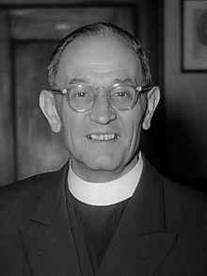
Give me a new heart and spirit!
Overcoming the spirit of apathy
“First they came for the Socialists,
and I did not speak out—
Because I was not a Socialist.
Then they came for the Trade Unionists,
and I did not speak out—
Because I was not a Trade Unionist.
Then they came for the Jews,
and I did not speak out—
Because I was not a Jew.
Then they came for me—and there was no one left to speak for me.
Martin Niemöller
Notes:
That doesn’t affect me, therefore I don’t care about it. It doesn’t matter until it happens to you. Famous quote from German pastor in WWII Martin Niemoller. God has called all of us to speak out, to pray for our cities and nation – seek the prosperity of the city Jer 29:7. When it prospers, so do you.
God has called all of us to stand for righteousness against the evil of our day. William Carey – father of modern missions stood against the unjust practice of Sati where widows would be burned alive on top of their deceased husbands in India, led a campaign for the humane treatment of lepers. All whilst still carrying out God’s work as a missionary.
William Wilberforce spoke against and dedicated his whole life to the abolition of slavery in the British Empire. When William Wilberforce entered parliament, he was one of only two born-again Christians in Westminster. By his death, there was over 100 Evangelicals in parliament, in England.
Open your mouth for the speechless, In the cause of all who are appointed to die. Open your mouth, judge righteously, And plead the cause of the poor and needy. - Proverbs 31:8-9
He has shown you, O man, what is good; And what does the Lord require of you But to do justly, To love mercy, And to walk humbly with your God? - Micah 6:8
Therefore I exhort first of all that supplications, prayers, intercessions, and giving of thanks be made for all men,for kings and all who are in authority, that we may lead a quiet and peaceable life in all godliness and reverence. For this is good and acceptable in the sight of God our Savior,who desires all men to be saved and to come to the knowledge of the truth. - 1 Timothy 2:1-4

Slide 12
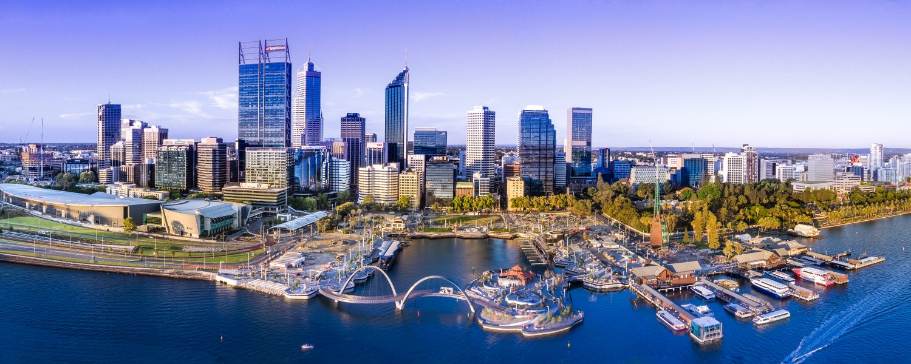
Give me a new heart and spirit!
Overcoming the spirit of apathy
Jer 29:7
And seek the peace of the city where I have caused you to be carried away captive, and pray to the Lord for it; for in its peace you will have peace.
Notes:
That doesn’t affect me, therefore I don’t care about it. It doesn’t matter until it happens to you. Famous quote from German pastor in WWII Martin Niemoller. God has called all of us to speak out, to pray for our cities and nation – seek the prosperity of the city Jer 29:7. When it prospers, so do you.
God has called all of us to stand for righteousness against the evil of our day. William Carey – father of modern missions stood against the unjust practice of Sati where widows would be burned alive on top of their deceased husbands in India, led a campaign for the humane treatment of lepers. All whilst still carrying out God’s work as a missionary.
William Wilberforce spoke against and dedicated his whole life to the abolition of slavery in the British Empire. When William Wilberforce entered parliament, he was one of only two born-again Christians in Westminster. By his death, there was over 100 Evangelicals in parliament, in England.
Open your mouth for the speechless, In the cause of all who are appointed to die. Open your mouth, judge righteously, And plead the cause of the poor and needy. - Proverbs 31:8-9
He has shown you, O man, what is good; And what does the Lord require of you But to do justly, To love mercy, And to walk humbly with your God? - Micah 6:8
Therefore I exhort first of all that supplications, prayers, intercessions, and giving of thanks be made for all men,for kings and all who are in authority, that we may lead a quiet and peaceable life in all godliness and reverence. For this is good and acceptable in the sight of God our Savior,who desires all men to be saved and to come to the knowledge of the truth. - 1 Timothy 2:1-4

Slide 13
Give me a new heart and spirit!
Overcoming the spirit of apathy
Prov 31:8-9 Open your mouth for the speechless,
In the cause of all who are appointed to die. Open your mouth, judge righteously, And plead the cause of the poor and needy.
1 Tim 2:1-4 Therefore I exhort first of all that supplications, prayers, intercessions, and giving of thanks be made for all men, for kings and all who are in authority, that we may lead a quiet and peaceable life in all godliness and reverence. For this is good and acceptable in the sight of God our Saviour, who desires all men to be saved and to come to the knowledge of the truth.
Notes:
Evil abounds when good people do nothing

Slide 14
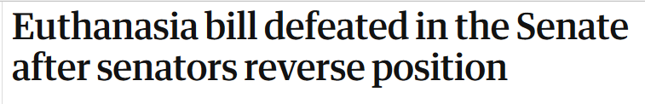
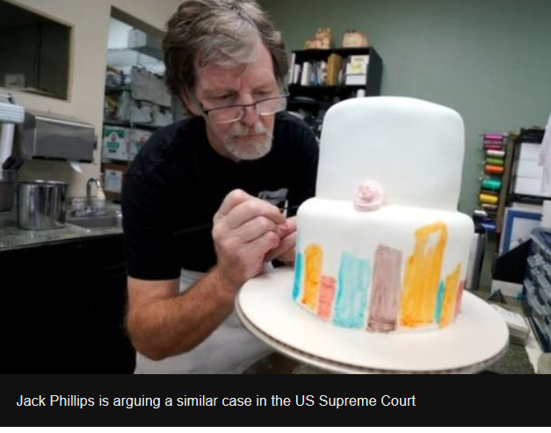

Give me a new heart and spirit!
Overcoming the spirit of apathy
Notes:
Never in history have we needed to pray more now than ever before
The church is the conscience of the state. We have a job to be the prophetic voice and to hold government accountable for their actions.
Why should Christians speak out – Eric Metaxas ACL

Slide 15
Give me a new heart and spirit!
Overcoming the spirit of apathy
Eze 36:26 I will give you a new heart and put a new spirit within you; I will take the heart of stone out of your flesh and give you a heart of flesh. I will put My Spirit within you and cause you to walk in My statutes, and you will keep My judgments and do them.

Slide 16
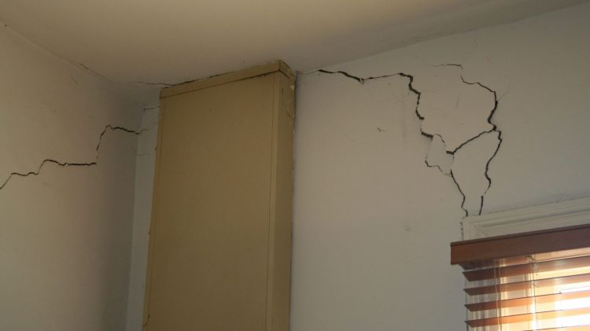
That I may know Him
Overcoming the spirit of familiarity
Our foundation is tested in times of pressure
Phil 1:6, 2:12
Notes:
We have been spending time covering Foundation material in Life Group and in the Advanced classes now on Sundays. Recently my brother discovered there are a few concerning cracks in his house. Concerning enough to contact the builder to check for structural integrity. If our foundation is not sure, cracks will appear in our lives. We can’t decorate the rooms if the foundation is not first laid. And we can’t hope to continue to live in the house if the foundation is not properly laid. There will be problems down the track.

Slide 17
Conclusion
Rev 21:7 He who overcomes will inherit all things, and I will be his God and he shall be My son
God has destined us to be overcomers!
Recognise the spirits operating, cast it out and change our mindsets to…
  Give me this mountain!
  Give me a new heart!
  That I may know Him!
Notes:
Rev 21:7 He who overcomes will inherit all things, and I will be his God and he shall be My son
God has destined us to be overcomers.
We don’t have to live in a cycle of constant defeat or a cycle of up and down where we fail to learn our lessons. Recognise the spirits operating, cast it out and change our mindsets to
Give me this mountain! There are yet many mountains for me to conquer!
Give me a new heart!
That I may know Him!

